Slide 1
ALL FOR LOVE
GROUP 4
Member:
Wang Hexiang(chemistry)
Li Chengwu(physics)
Hao Xinpei(biology)

Slide 2

ALL
FOR
LOVE
ALL
FOR
LOVE
Member: Li Chengwu, Hao Xinpei, Wang Hexiang

Slide 3

ONE
1.Problem
statement
I will do somebody a good turn and not get found out: If anybody knows of it, it will not count.
I will do somebody a good turn and not get found out: If anybody knows of it, it will not count.
TWO
2.Analysis
THREE
3.Design
ALL
FOR
LOVE
I will do somebody a good turn and not get found out: If anybody knows of it, it will not count.
I will do somebody a good turn and not get found out: If anybody knows of it, it will not count.
FOUR
4.Implementation
THREE
5.Test

Slide 4
01.PROBLEM STATEMENT

Slide 5

problem statement
Battle
Rescue
Love
Why？
For what？

Slide 6
02.ANALYSIS

Slide 7
Analysis
1.Keyboard controls character movement
2.Players need to get the key, open the treasure box, in order to win
3.The enemy (zombies) will find the same line of enemies and take the shortest path to pursue
4.The game fails if the player makes contact with the enemy
5.The player opens the treasure box then the game succeeds

Slide 8
03.DESIGN

Slide 9
3.1 Roles and Responsibilities
Li Chengwu
Hao Xinpei
Wang Hexiang
ALL FOR LOVE
Game engine & Interface
Algorithm
(A*)
Control

Slide 10
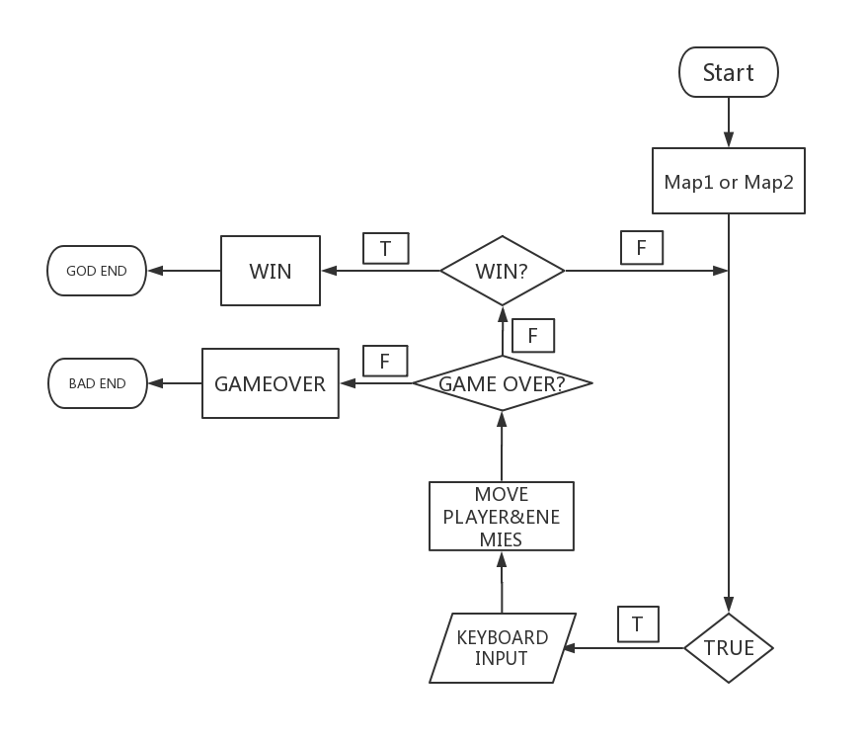
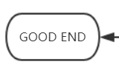
3.2 Game Logic

Slide 11
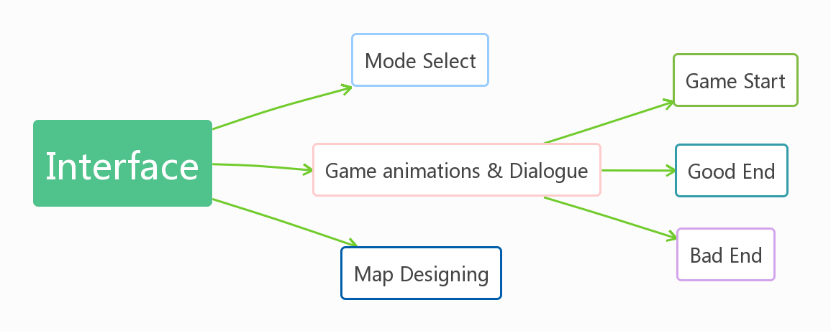
3.3 Interface

Slide 12
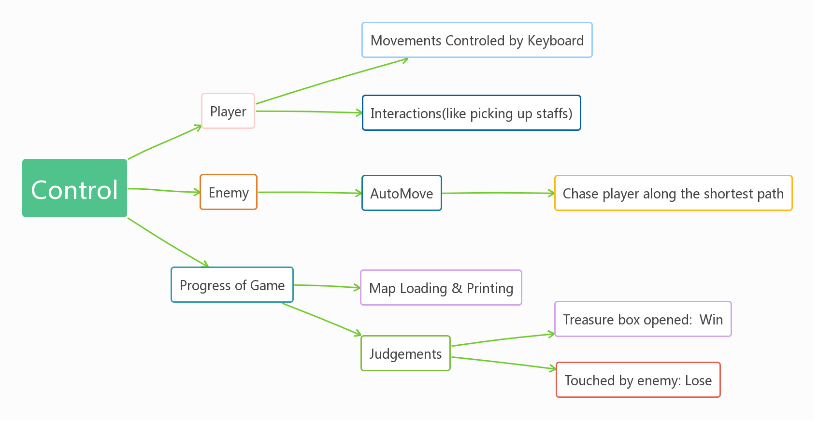
3.4 Control

Slide 13
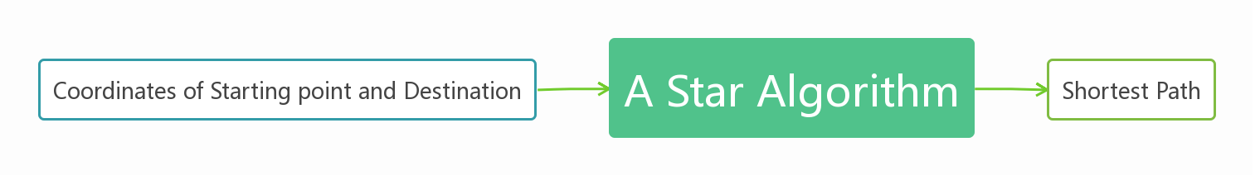
3.5 A Star Algorithm + Flowchart

Slide 14
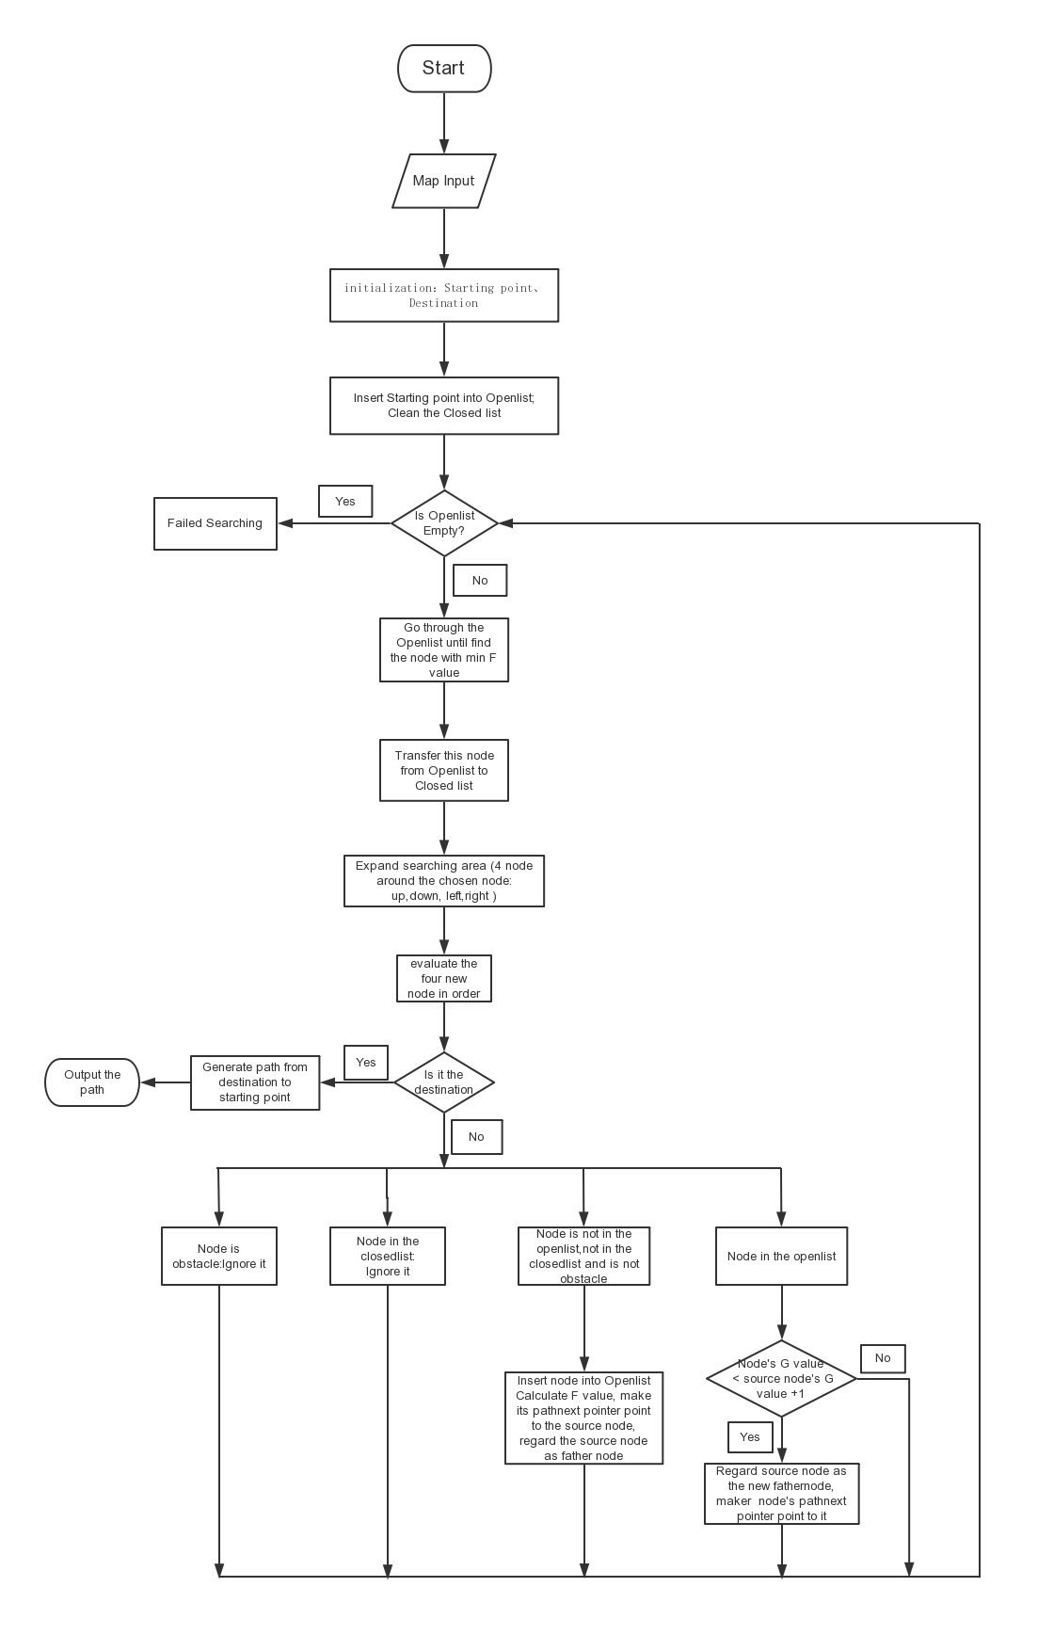
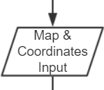

Slide 16
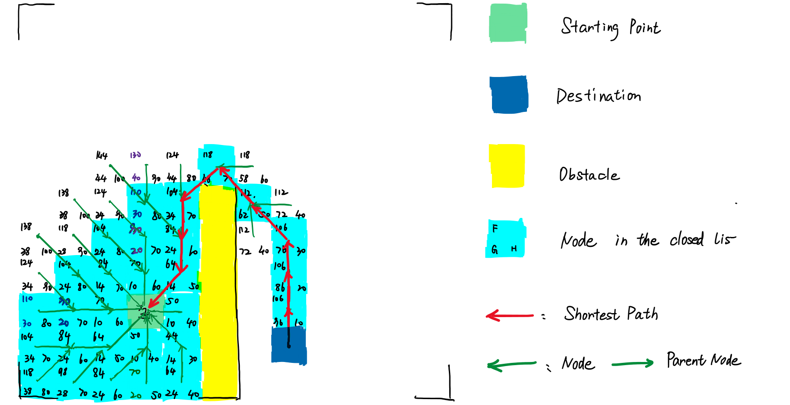

Slide 17
04.IMPLEMENTATION

Slide 18
Programming Tools
Microsoft Visual Studio 2017
“Rupeng” game engine

Slide 19
Interface
Use the “Rupeng” game engine to load images and get mouse clicks.

Slide 20

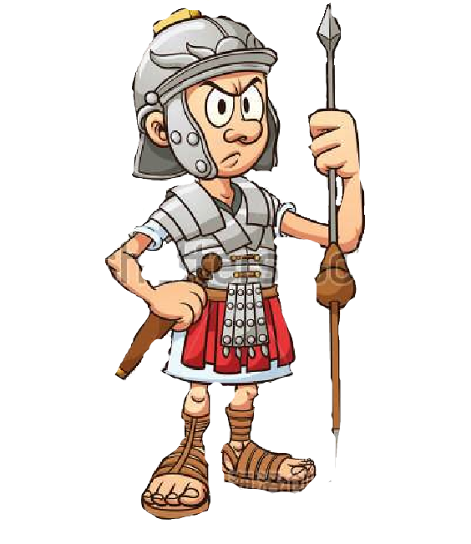


Female general
The King
The enemy soldier
The queen

Slide 21

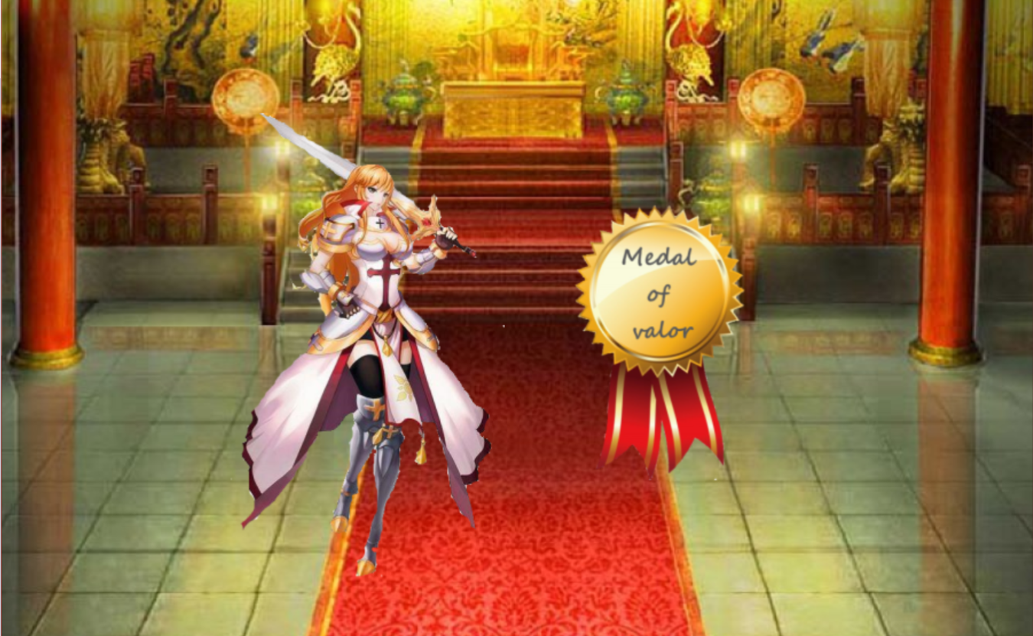
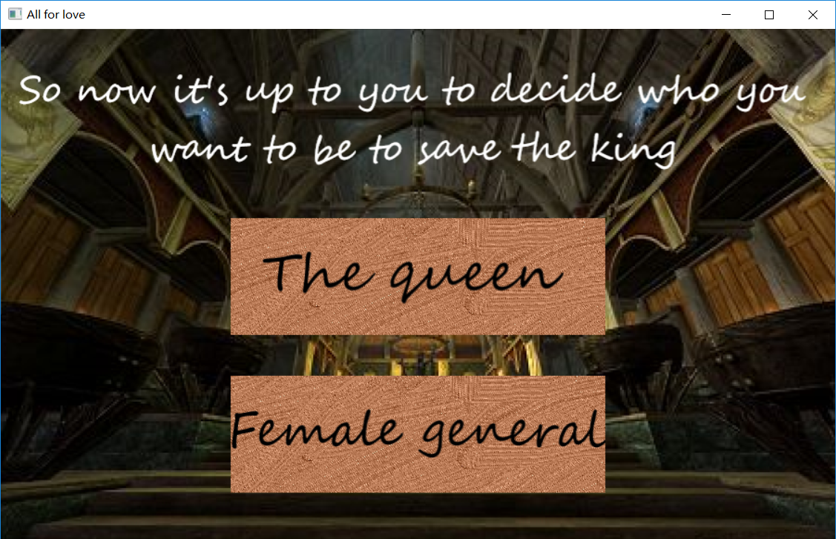
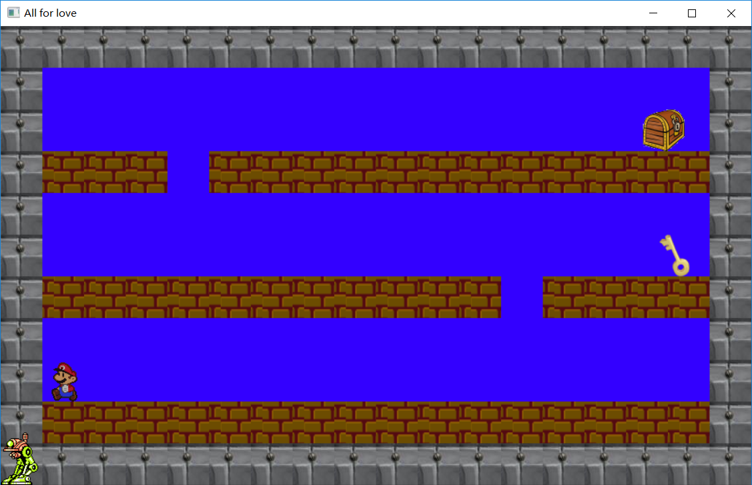



Slide 22
Control part

Slide 23
Control part 1：player
Use player structure to store player information
Get keyboard input to move players
Jump (with the help of game engine)
Interact with staffs on the map
Gravity：make sure the player is standing on the ground.

Slide 24
Control part 2：enemies
Use a linked list to store enemy information
Use A * algorithm to get “next coordinate”
Move based on the coordinate

Slide 25
Control part 3：progress of game
Initialize the game
Read map array from a txt file
Load map based on the array
Make sure all moves are achievable
Judge the game victory or failure
Press “Enter” to pause the game

Slide 26
A * algorithm
Use two linked lists to classify different nodes
Translate Map Array
Operations on linked lists :
insert in order; delete; print;

Slide 27
05.TEST

Slide 28
WHOLE PROCESS (38s)
Failed (11s)
Victory (22s)

Slide 29
Thanks
FOR WATCHING & LISTENING

Slide 30
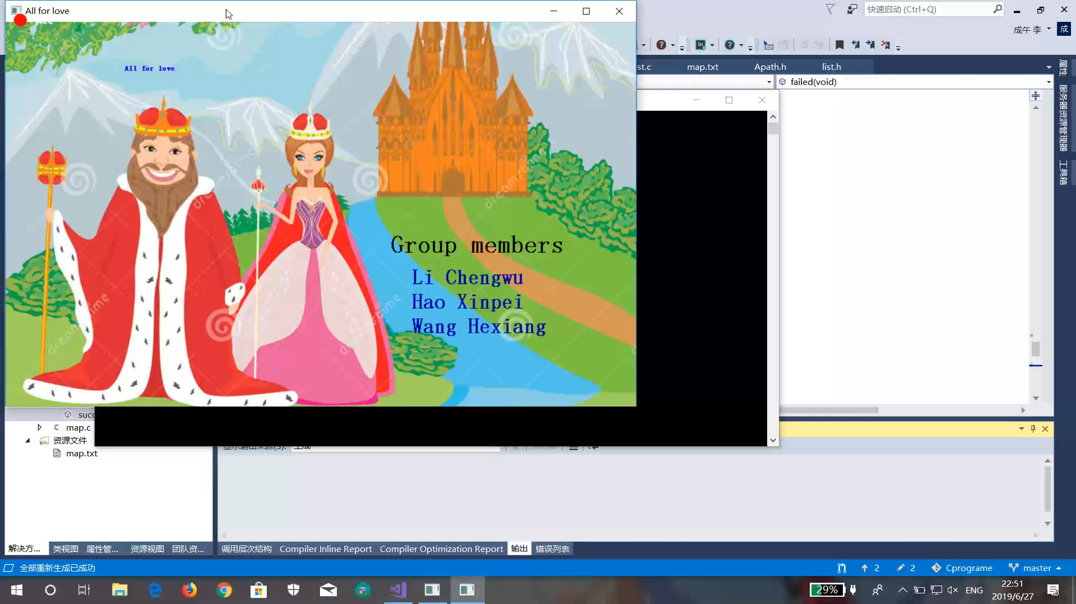
WHOLE PROCESS

Slide 31
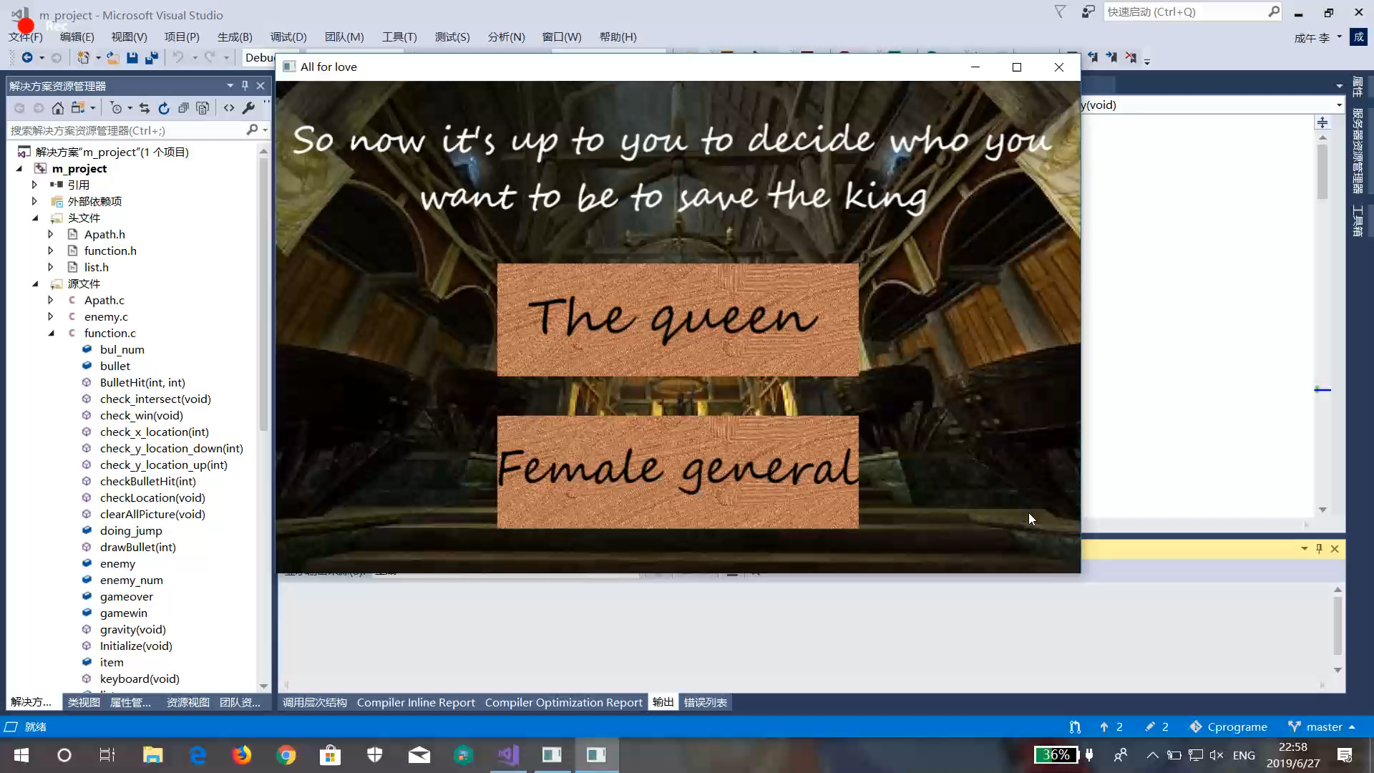
failed

Slide 32
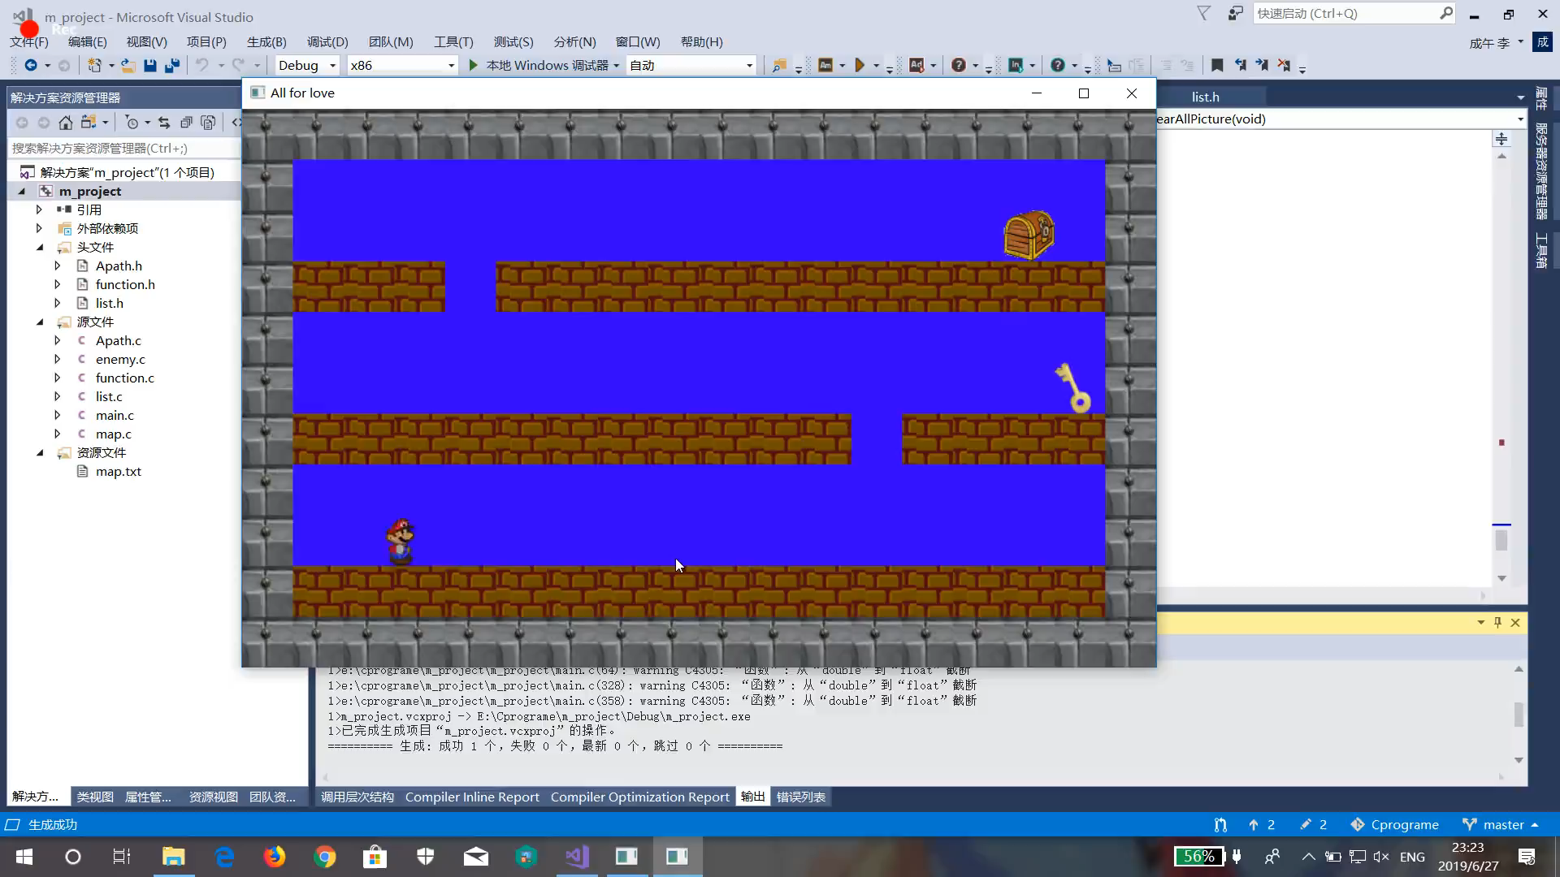
victory

